Slide 1

Software Application Development
- Tools for Product Activities-
GitHub
2022
Young J. RHO
Notes:
1
Thomas Friedman’s work
Additional resources and websites:
http://www.thomaslfriedman.com/bookshelf/the-world-is-flat
“The Lexus and the Olive Tree,” http://www.thomaslfriedman.com/bookshelf/the-lexus-and-the-olive-tree; finding a proper balance in business with this new globalization/online business environment

Slide 2
Possible for My Project
Objects Activities | Product | Process | People
Management
Measurement
Development
Configuration M
(Product M)
Project M
Team M
Roles
Git for version control
Excel for scheduling
Quality
Productivity
Ability
M-V-C
Data size(Model)
UI size(View)
Program size(Control)
Documentation
Teamwork
Development Tools
SW Process
Training / Education
Target environment
Client & server
Development env.
Agile method
Required skills

Slide 3
GitHub
Topical Contents
GitHub SignUp
Tools
Creation and Deletion of repository in the GitHub
Tools
GitHub Desktop
Roles, skills & communications

Slide 4

Tools for Product Management
Version control and coworking
GitHub

Slide 5
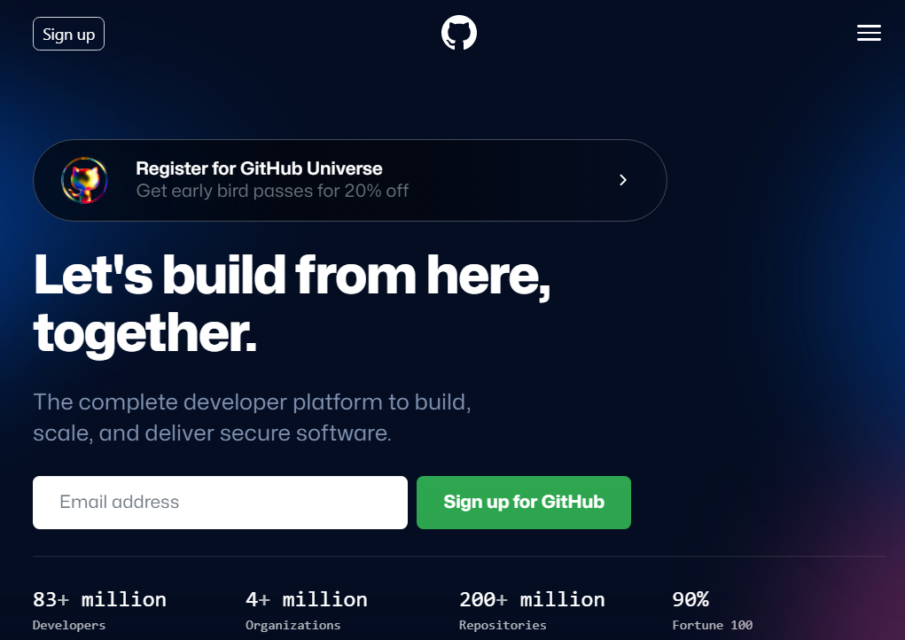
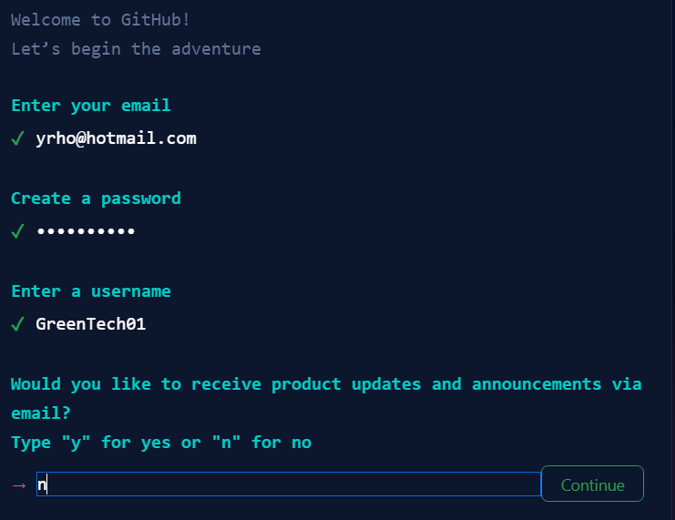
GitHub
Sign up
Your email
Password
User name
Authentication through the registered email

Slide 6
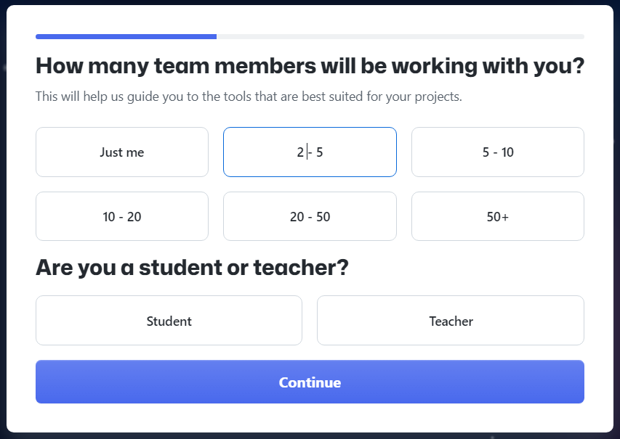
GitHub
Cont’ to sign up

Slide 7
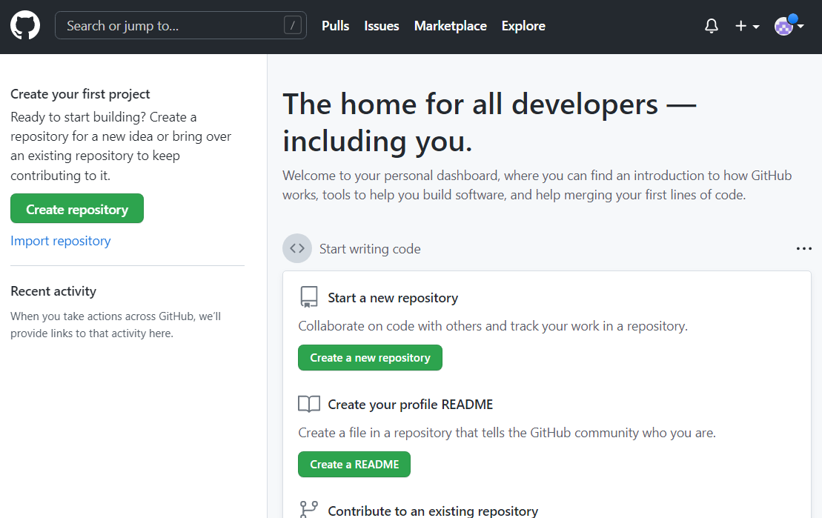
GitHub
Create a new repository
In the GitHub ubder your account

Slide 8
GitHub
Create a new repository
In the GitHub ubder your account

Slide 9
GitHub
Cont’ to create a new repository

Slide 10
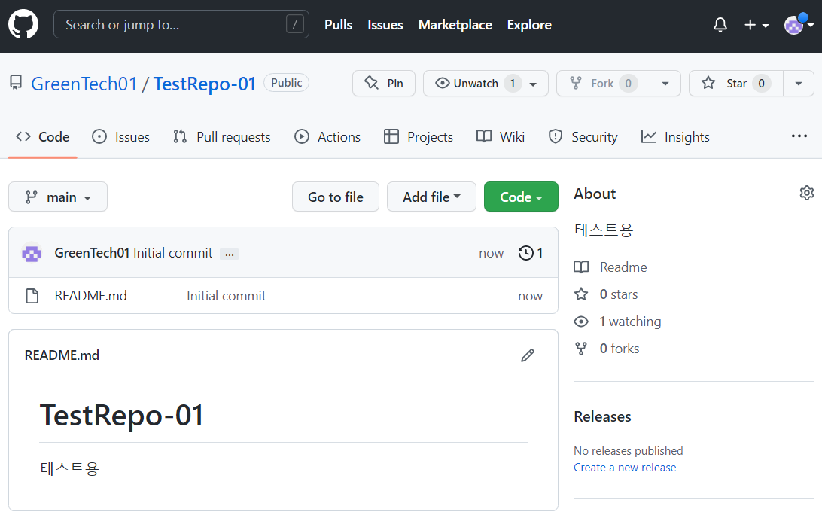
GitHub
Create a new repository
In the GitHub ubder your account

Slide 11
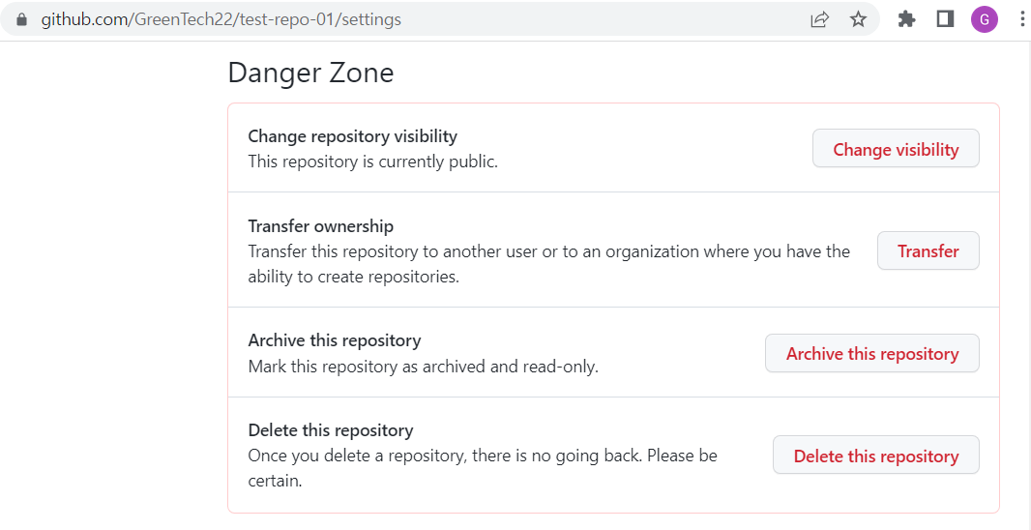
GitHub
Delete repository
Select the target repository, then
Settings and Danger Zone

Slide 12
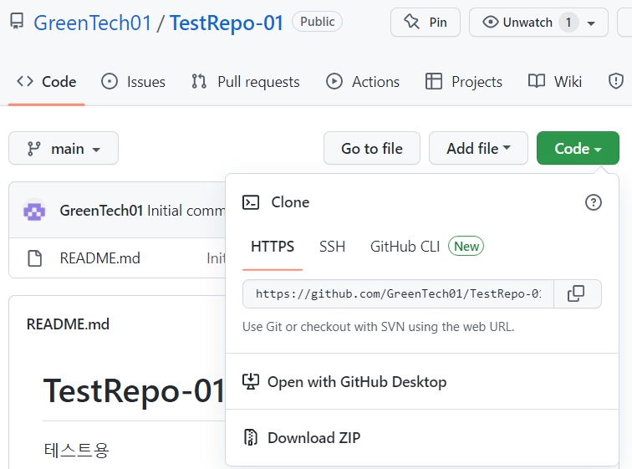
GitHub
GitHub Desktop
Select

Slide 13
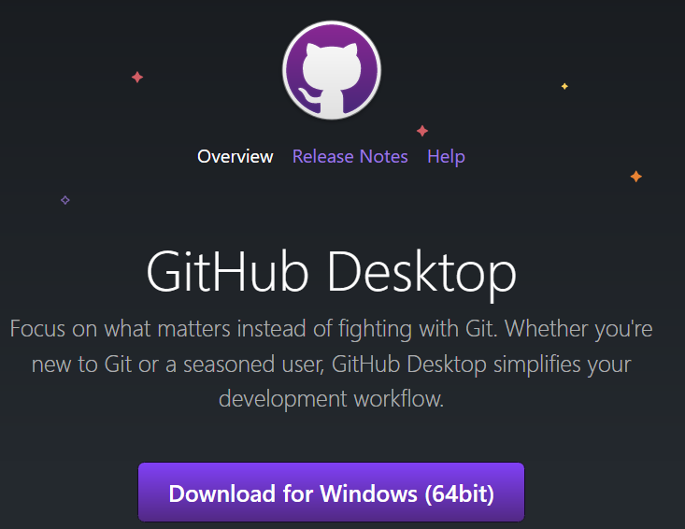
GitHub
Installation of GitHub Desktop
Download if not installed already

Slide 14
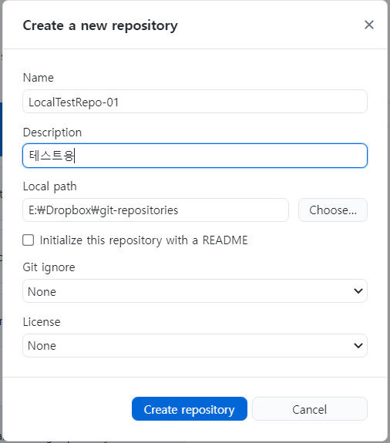
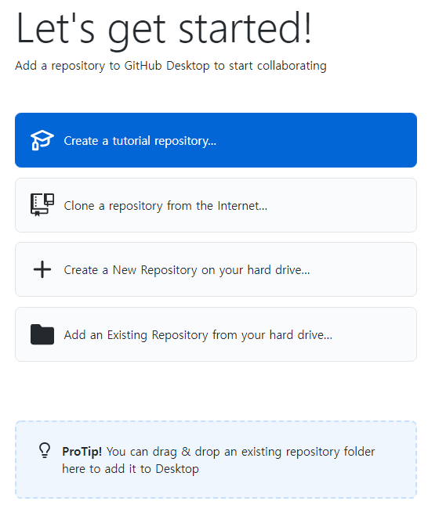
GitHub
GitHub Desktop
Create a local repository

Slide 15
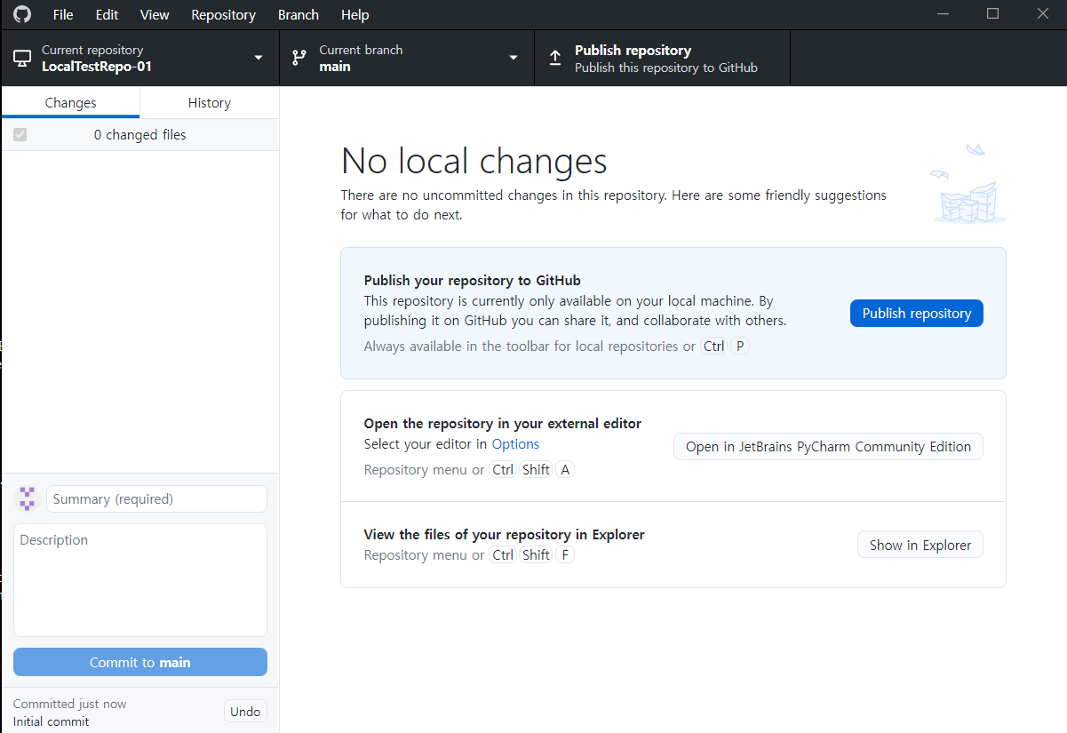
GitHub
GitHub Desktop
Publish the repository to the GitHub

Slide 16
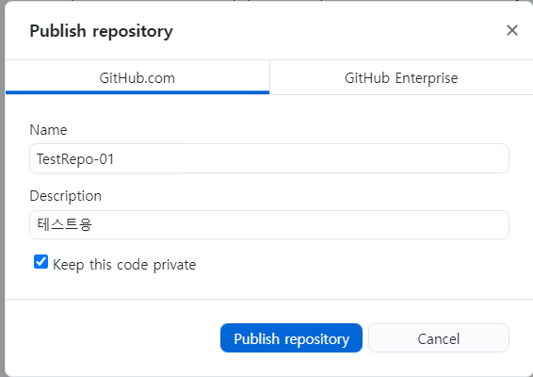
GitHub
GitHub Desktop
Publish the repository to the GitHub

Slide 17
GitHub
GitHub Desktop
Publish the repository

Slide 18
GitHub
GitHub Desktop
Publish the repository

Slide 19
2. Tools for Process Activities
Tools for process development
Tools for process measurement
Tools for process management

Slide 20
Tools for Process Development
Four stages
Idea Engineering
Development Engineering
Service Engineering
Feedback
Desire Into Service
Service into Desire
Engineering Lifecycle
Idea Engineering
Development Engineering
Service Engineering
Feedback

Slide 21

Tools for Process Development
Idea Engineering
Process of Idea Engineering
Define a problem
Generate idea (Brainstorming)
Evaluate idea
Judge
Integrate and Enhance the Idea
Review
Desire Into IDEA
IDEA

Slide 22




Tools for Process Development
Four Golden Rules of Brainstorming
Any
As many
Hitchhiking
No criticism
Idea Engineering

Slide 23
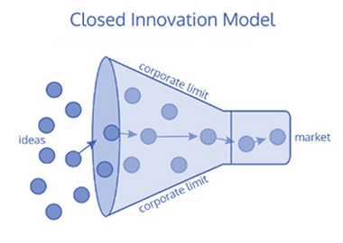
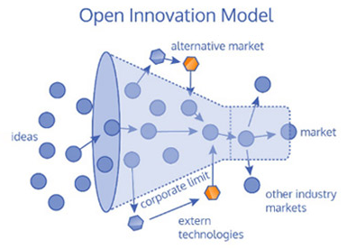


Tools for Process Development
Idea Engineering
Two IE Models
Closed Idea Engineering Model
Open Idea Engineering Model
Idea
Idea

Slide 24
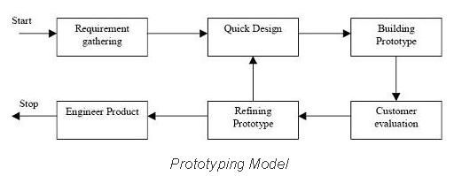
Tools for Process Development
Development Engineering
Prototyping Model

Slide 25
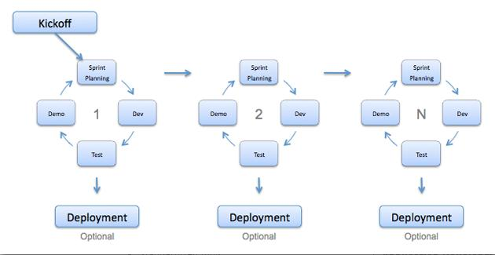

Tools for Process Development
Development Engineering
Agile Method

Slide 26
Tools for Process Measurement
Model
Idea documentation
Document outcomes from analysis, design
Program
Coding conventions
TLOC per week

Slide 27
3. Tools for People Activities
Tools for people development
Tools for people measurement
Tools for people management

